Slide 1
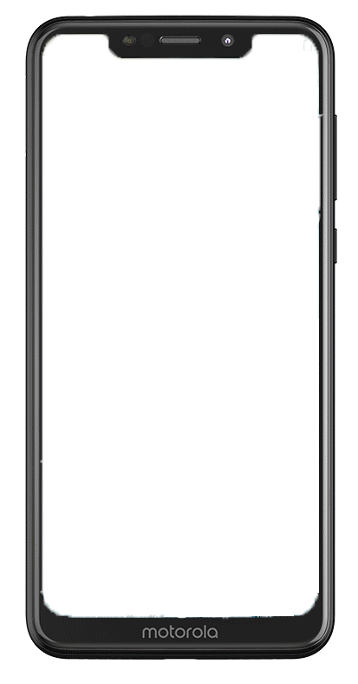
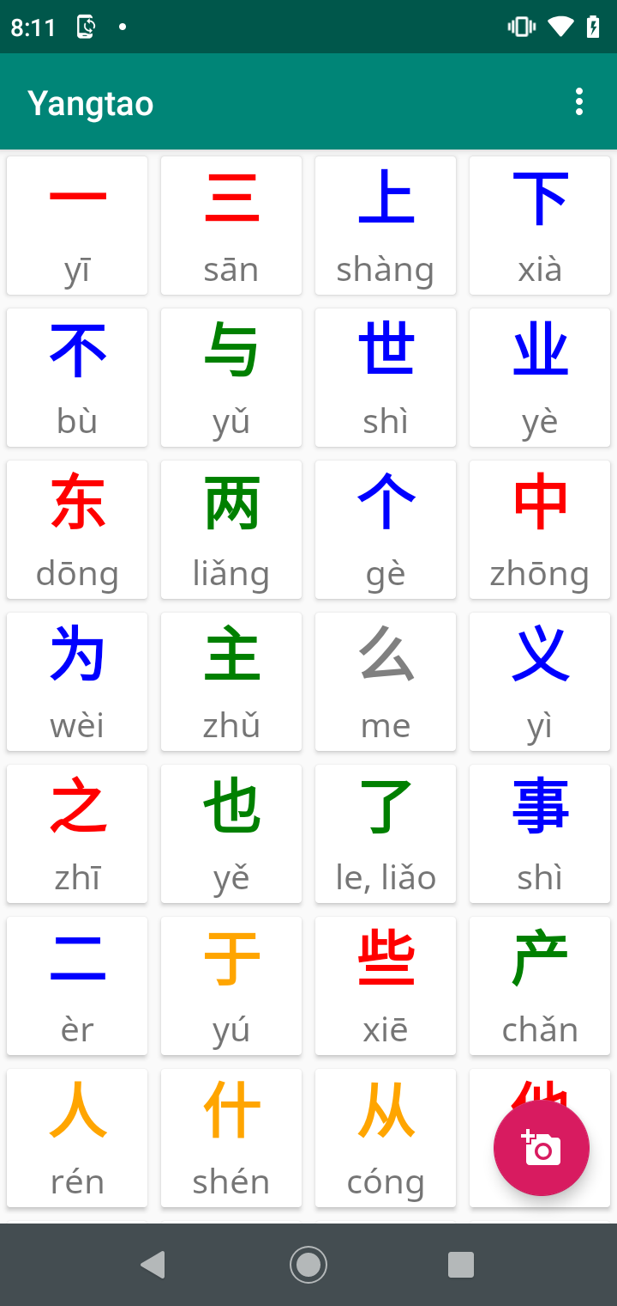
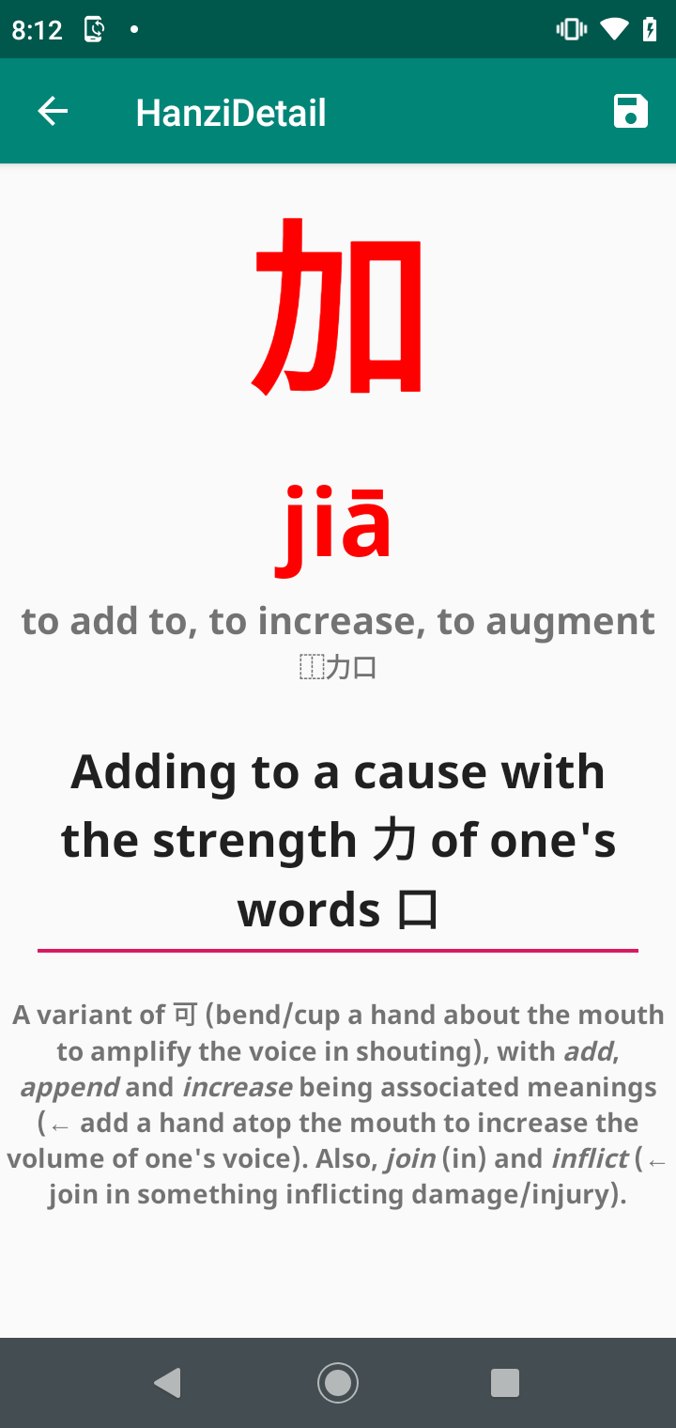
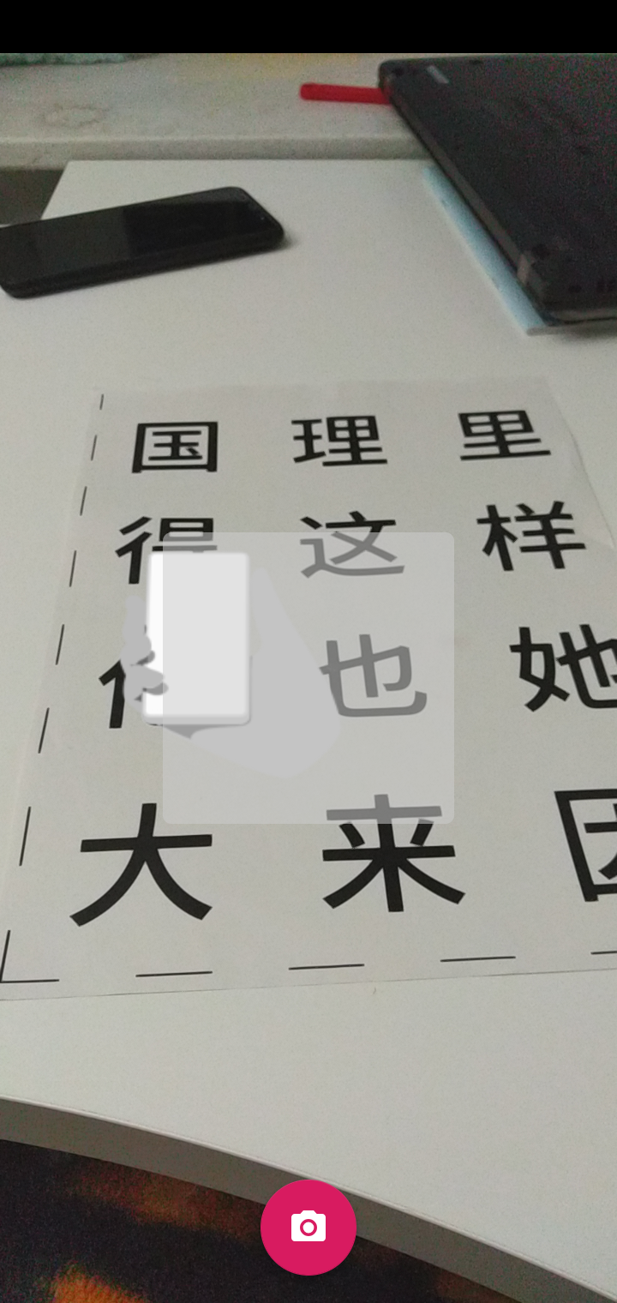
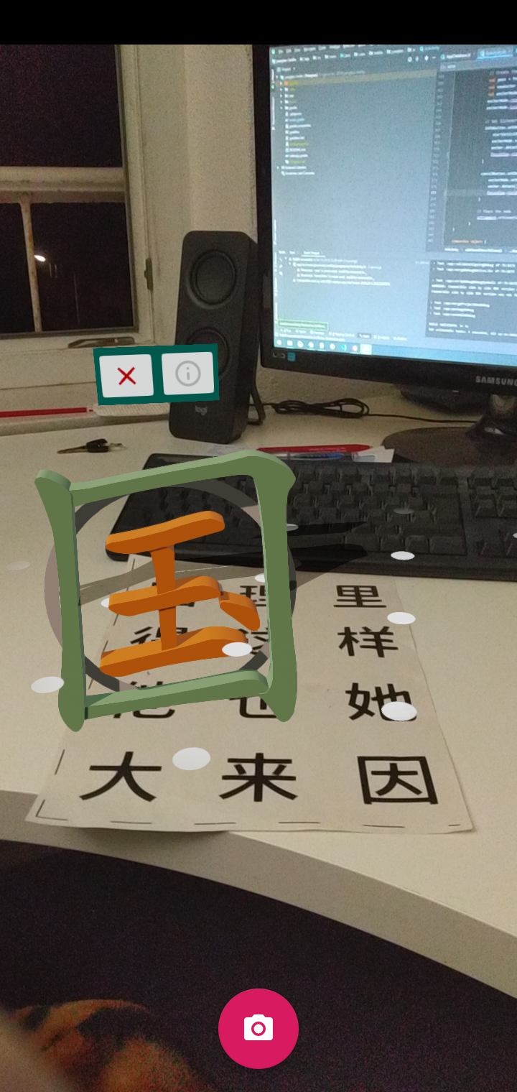
Yangtao - AR App for Interactively Learning and Exploring Chinese Characters
Chinese characters are an essential part of the Chinese language and culture. They are an integral part of becoming proficient in Mandarin. Learning even only the most common 2000-3000 characters is an arduous task that requires many hours of study. To support students, we implemented an augmented reality smart phone app for interacting with Chinese characters.
When pointing the smart phone camera to a single character, we identify the character with machine learning and show its 3D representation above it. Its etymology, decomposition and mnemonic can be looked up. We use the knowledge about how the brain works and learns so that our users can better and more efficiently remember all the Hanzi. This is done by e.g. teaching character decompositions 六書, showing the decomposition in the 3D view or helping users coming up with mnemonics to connect Hanzi parts to a story.
Grid View
Detail View
Scanning View
3D View

Slide 2
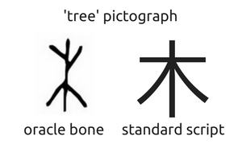
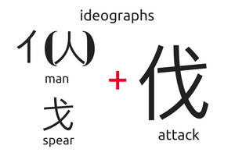
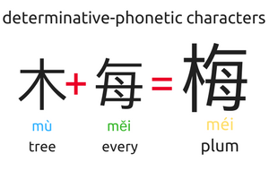
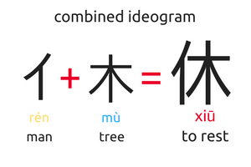
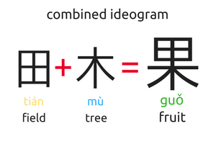
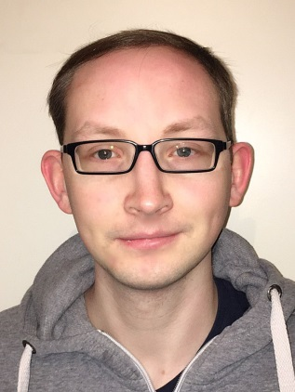
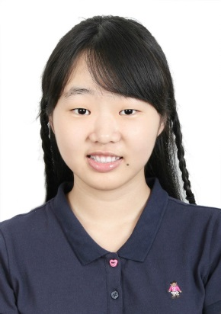
The learning process implemented in Yangtao relies on the Dual Coding Theory of Reading and Writing which states that the brain best remembers if the item to remember, in this case Hanzi, is associated with as many different cues as possible. Therefore, we present the users with visual cues (the 3D Hanzi), audio cues (the pronunciation) and the logic behind the Hanzi (its decomposition, etymology and kind of formation).
A mnemonic for 休 could be e.g. a man leaning on a tree to rest, which is arguably easier to remember than learning its meaning by rote. The first app prototype is available for Android and uses Google ARCore, Sceneform and tflite. The character recognition itself uses a feed-forward neural network that is fed with HOG (Histogram of oriented gradients) features from filtered camera images.
Our prototype supports 250 selected characters. In the next iteration, we want to add online learning/lifelong learning capabilities so that the character recognition is improved by user feedback if it was wrong, adapting the app to the users’ environment. This is similar to how the brain continually learns and adjusts.
Jan-Christoph Klie (杨洋) is a second year PhD student at TU Darmstadt, Germany in Natural Language Processing. Currently, he researches how text annotation can be interactively supported by machine learning. He was responsible for the app development and the technical document. In his free time, he likes to swim, read, program and to learn Chinese.
Yelan Tao (陶晔澜) is a senior undergraduate from School of Vehicle and Mobility at Tsinghua, China. She converted characters into 3D models and designed different material properties for them with Blender, prepared the presentation and the videos as well as managed the team. Her hobbies include playing soccer, reading, drawing and learning German.

